Slide 1
IS212 Software Project Management
Application Demo& Progress Update
G4T4
Project Manager: Tricia Tan
Tsang Bao Xian | Casper Lim Zhi Xin | Ong Yan Ning | Loh Xiao Binn

Slide 2
Functionalities
Wiki Question | Answer
Do you plan to drop/add any functionalities? | No
Do you plan to use any PHP frameworks? | No
Did you manage to finish login + 1 functionality? | Yes
What functionalities have you finished? | Login, add bid, bootstrap, [NEW] Update bid, delete bid, JSON web service (partial), round 1 clearing logic (partial)
What is the IP address & admin password for your cloud deployment? | IP Address: 54.169.210.219 Admin password: @dm1in5PM

Slide 3
Schedule Overview
Weekly Meetings on Tuesdays and Fridays.
Task set on Friday has deadline on Tuesday → 4 Working Days
Task set on Tuesday has deadline on Friday → 3 Working Days

Slide 4

Planned Iterations
Status: On schedule
Iteration | Task | Start Date | End Date
1 | Login, Add bid, Bootstrap Functionality | Monday of Week 5 | Sunday of Week 6
2 | Drop bid, Slides for PM review, Web service, Update bid | Monday of Week 7 | Thursday of Week 9
3 | Rounds, Drop section, Dumping | Friday of Week 9 | Thursday of Week 11
4 | Deploying to AWS, UAT, Check UAT results, testing, debugging, redeploy | Friday of Week 11 | Thursday of Week 13
5 | Prepare Final presentation slides | Friday of Week 13 | Sunday of Week 14

Slide 5
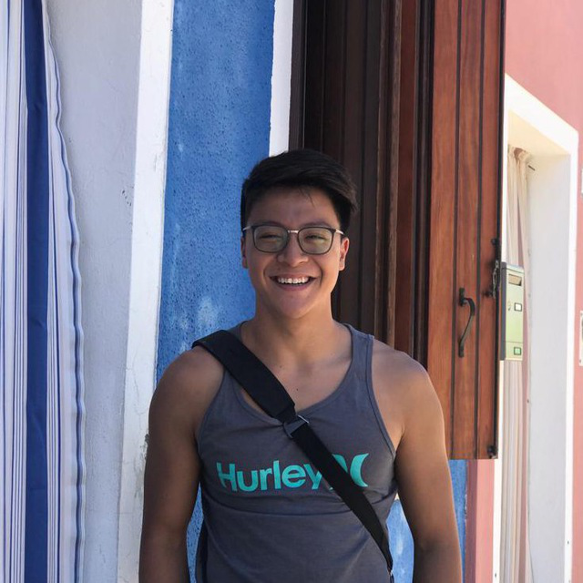
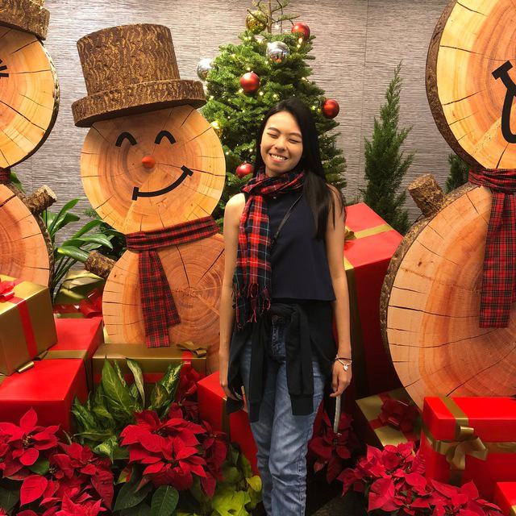
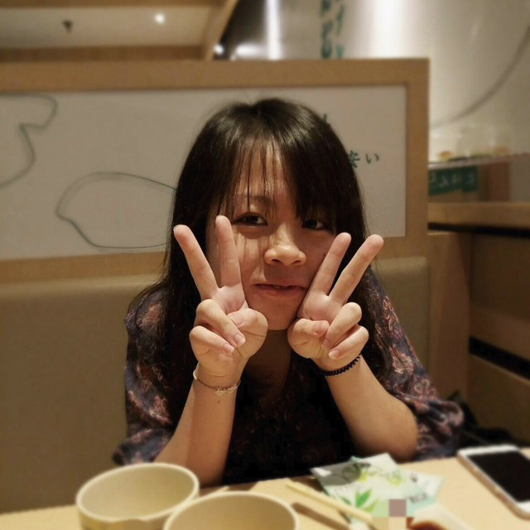


Roles & Task Allocation
d
Bao Xian
Coder
Loh Xiao Binn
Coder
Tricia Tan
Project Manger, Coder
Yan Ning
Coder
Casper Lim
Coder

Slide 6

Milestones and PMs in-charge
PM Review
PM: Bao Xian
Application Demo
PM: Tricia
User Acceptance Test (UAT)
PM:Xiao Binn
Final Submission
PM: Casper
27 Sep
13 Oct
27 Oct
10 Nov
21 Nov
3 Oct
17 Oct
31 Oct
17 Nov
End of Iteration 1
PM: Bao Xian
End of Iteration 2
PM: Tricia
End of Iteration 3
PM: Xiao Binn
End of Iteration 4
PM: Casper
Final Presentation
PM: Yan Ning

Slide 7
Buffer Time
Deadlines set at next meeting
Taking over/ Helping each other at meetings if any of us face any difficulties
Use Meeting time as buffer to debug

Slide 8
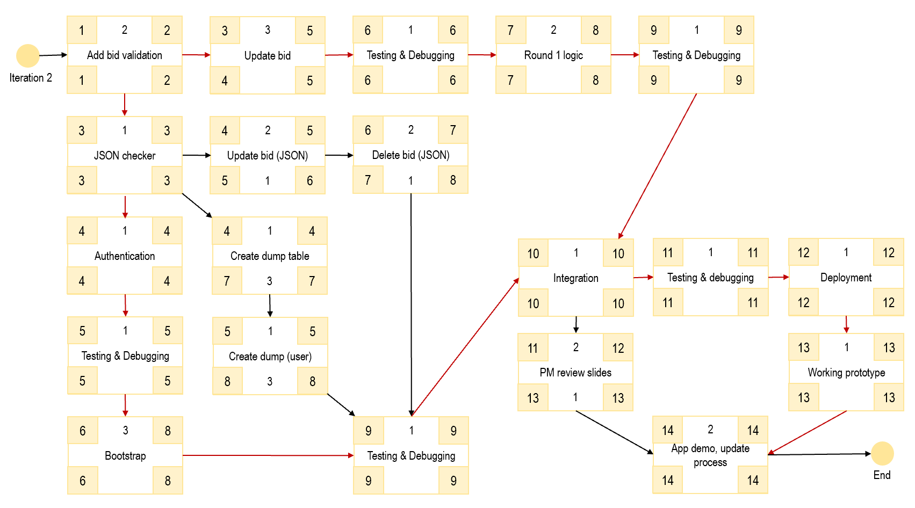
Critical Paths
(Iteration 2)
Number of critical paths: 2

Slide 9
2
6
1
2
1
Testing & Debugging
3
6
7
Round 1 logic
8
9
Testing & Debugging
1
9
Add bid validation
2
3
Update bid
5
Iteration 2
1
2
4
5
6
6
7
8
9
9
1
6
2
Delete bid (JSON)
3
2
7
JSON checker
3
4
Update bid (JSON)
5
3
3
5
1
6
7
1
8
4
1
1
Authentication
4
4
Create dump table
4
1
12
1
Deployment
11
12
Testing & debugging
10
1
11
Integration
10
4
4
7
3
7
10
10
11
11
12
12
5
1
Testing & Debugging
5
5
1
Create dump (user)
5
2
13
1
Working prototype
11
13
PM review slides
12
5
5
8
3
8
13
1
13
13
13
14
2
App demo, update process
6
3
1
14
Bootstrap
8
9
Testing & Debugging
9
6
8
9
9
14
14
End

Slide 10
Bug Metrics
(Iteration 2)
0
Current Bug Metrics:
Did you have to take any action according to your mitigation plan?
Debugging sessions are arranged when iteration points > 10
Debugging session was carried out during group meetings

Slide 11
Paired Programming Rotation
(Iteration 2)
Update Bid
function
Yan Ning,
Tricia
Drop/Delete Bid
function
Casper,
Xiao Binn
JSON
Web Service
Casper,
Bao Xian
Round 1 Clearing Logic
Xiao Binn,
Tricia

Slide 12
Thank You

